Slide 1
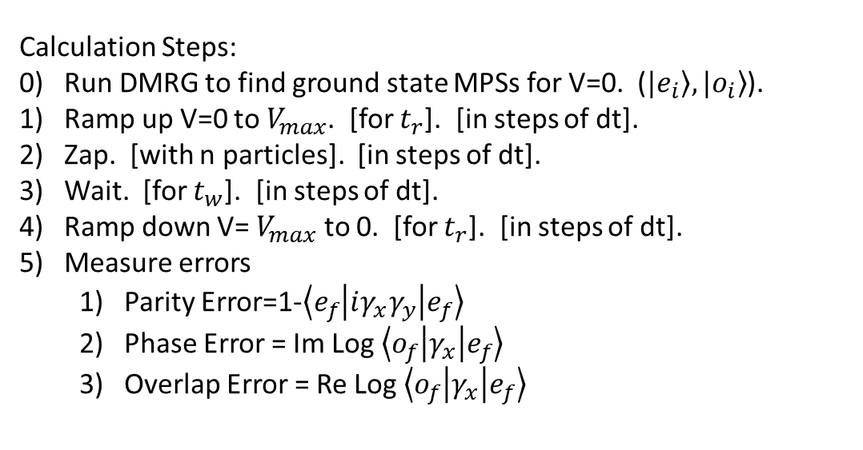
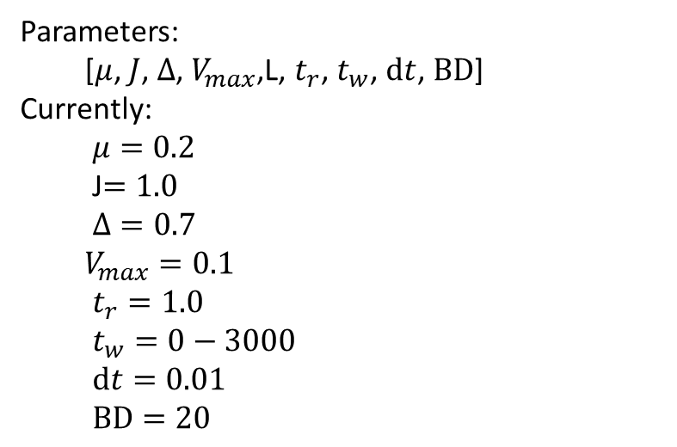
$$H=μ\sum_{i=0}^{L−1}{c_{i}^{†}c_{i}}+J\sum_{i=0}^{L−1}{(c_{i}^{†}c_{i+1}+c_{i+1}^{†}c_{i})}+Δ\sum_{i=0}^{L−1}{(c_{i}^{†}c_{i+1}^{†}+c_{i+1}c_{i})}+V\sum_{i=0}^{L−1}{c_{i}^{†}c_{i}c_{i+1}^{†}c_{i+1}}$$
Calculation Steps:
0) Run DMRG to find ground state MPSs for V=0. ($\left.|e_{i}\right\rangle ,\left.|o_{i}\right\rangle$).
Ramp up V=0 to $V_{max}$. [for $t_{r}$]. [in steps of dt].
Zap. [with n particles]. [in steps of dt].
Wait. [for $t_{w}$]. [in steps of dt].
Ramp down V= $V_{max}$ to 0. [for $t_{r}$]. [in steps of dt].
Measure errors
Parity Error=1-$\left\langle e_{f} | iγ_{x}γ_{y} | e_{f}\right\rangle$
Phase Error = Im Log $\left\langle o_{f} | γ_{x} | e_{f}\right\rangle$
Overlap Error = Re Log $\left\langle o_{f} | γ_{x} | e_{f}\right\rangle$
Parameters:
[$μ$, $J$, $Δ$, $V_{max}$,L, $t_{r}$, $t_{w}$, $dt$, $BD$]
Currently:
$μ=0.2$
J$=1.0$
$Δ=0.7$
$V_{max}=0.1$
$t_{r}=1.0$
$t_{w}=0−3000$
$dt=0.01$
$BD=20$

Slide 2
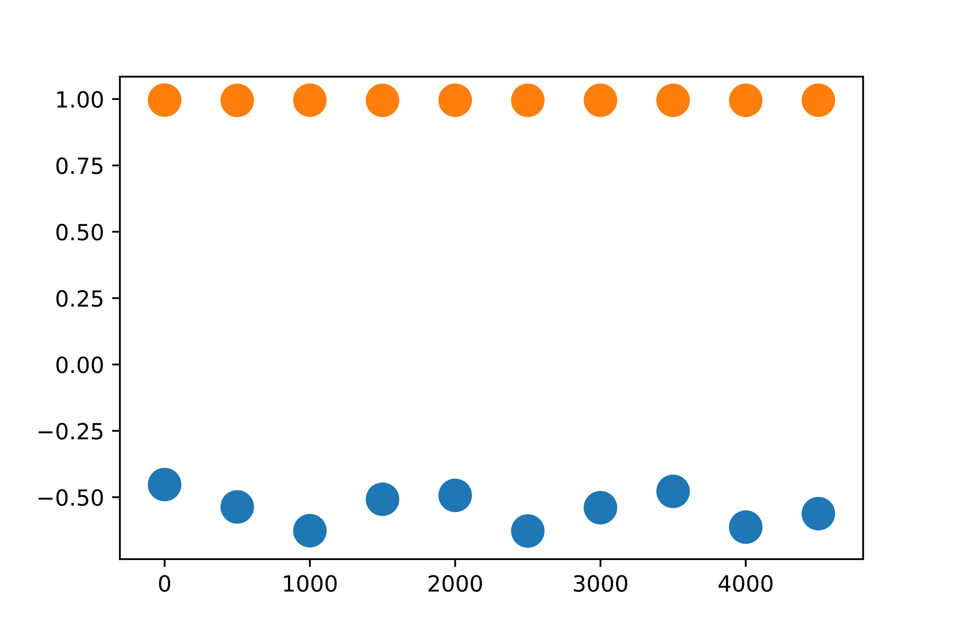
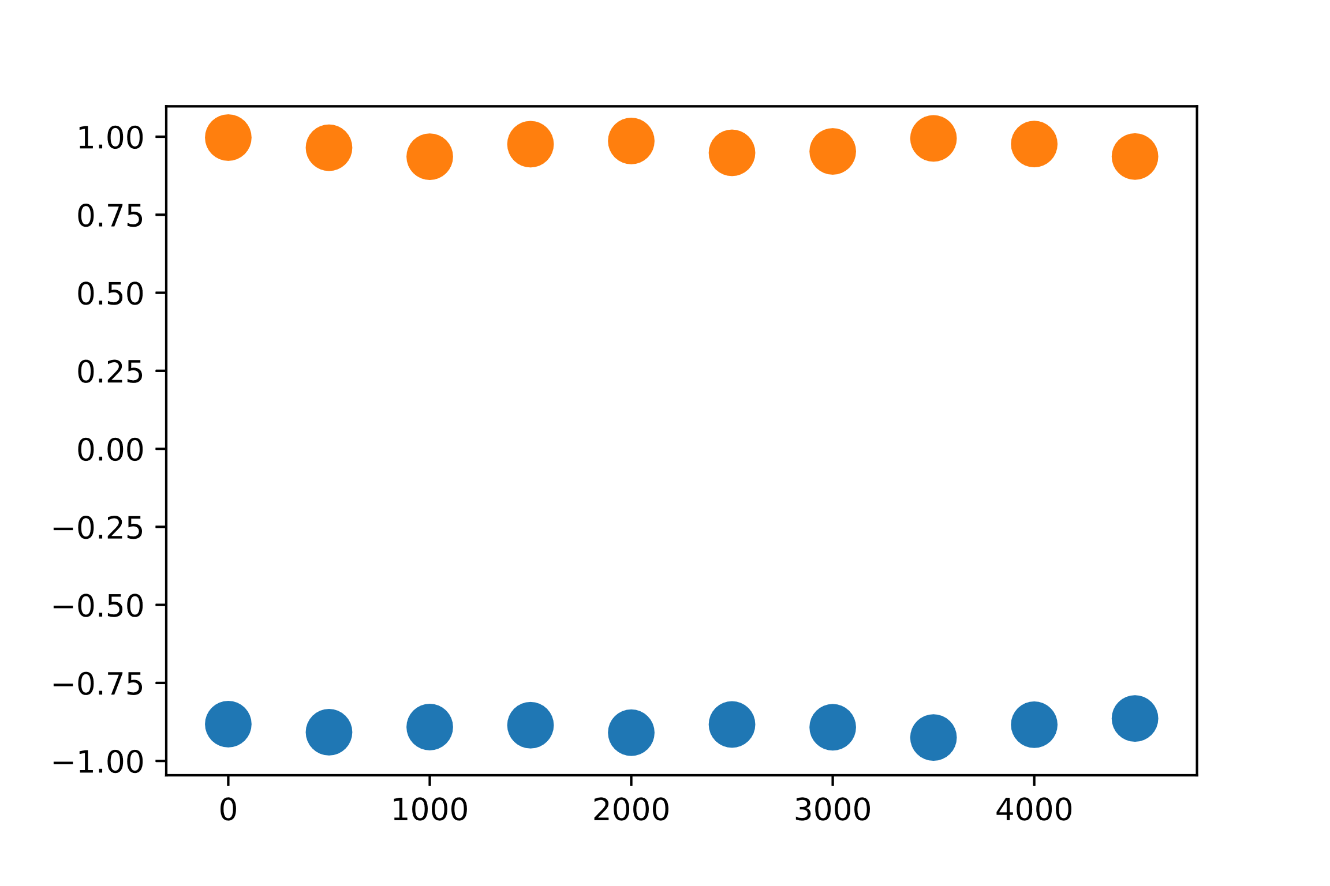
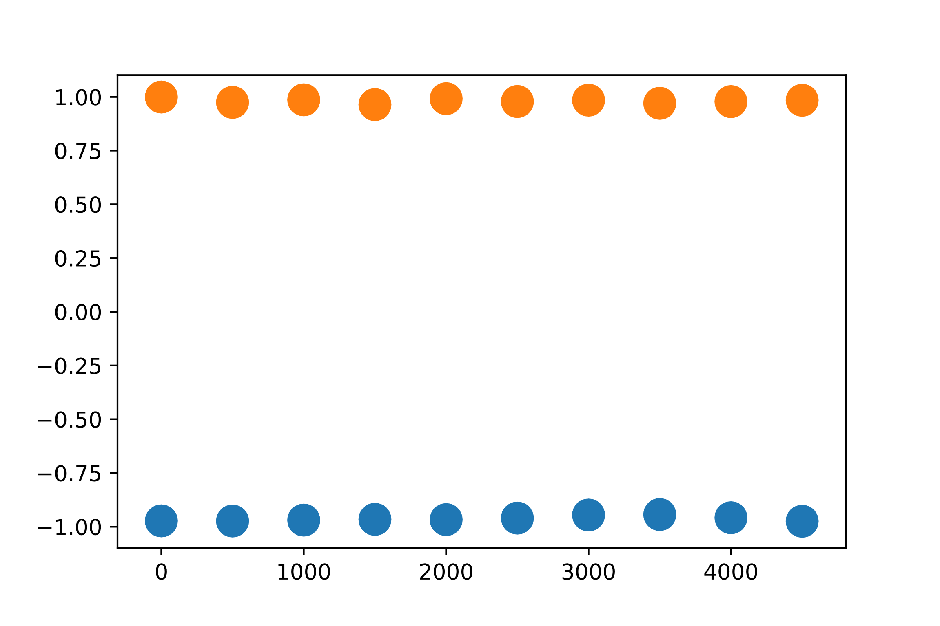
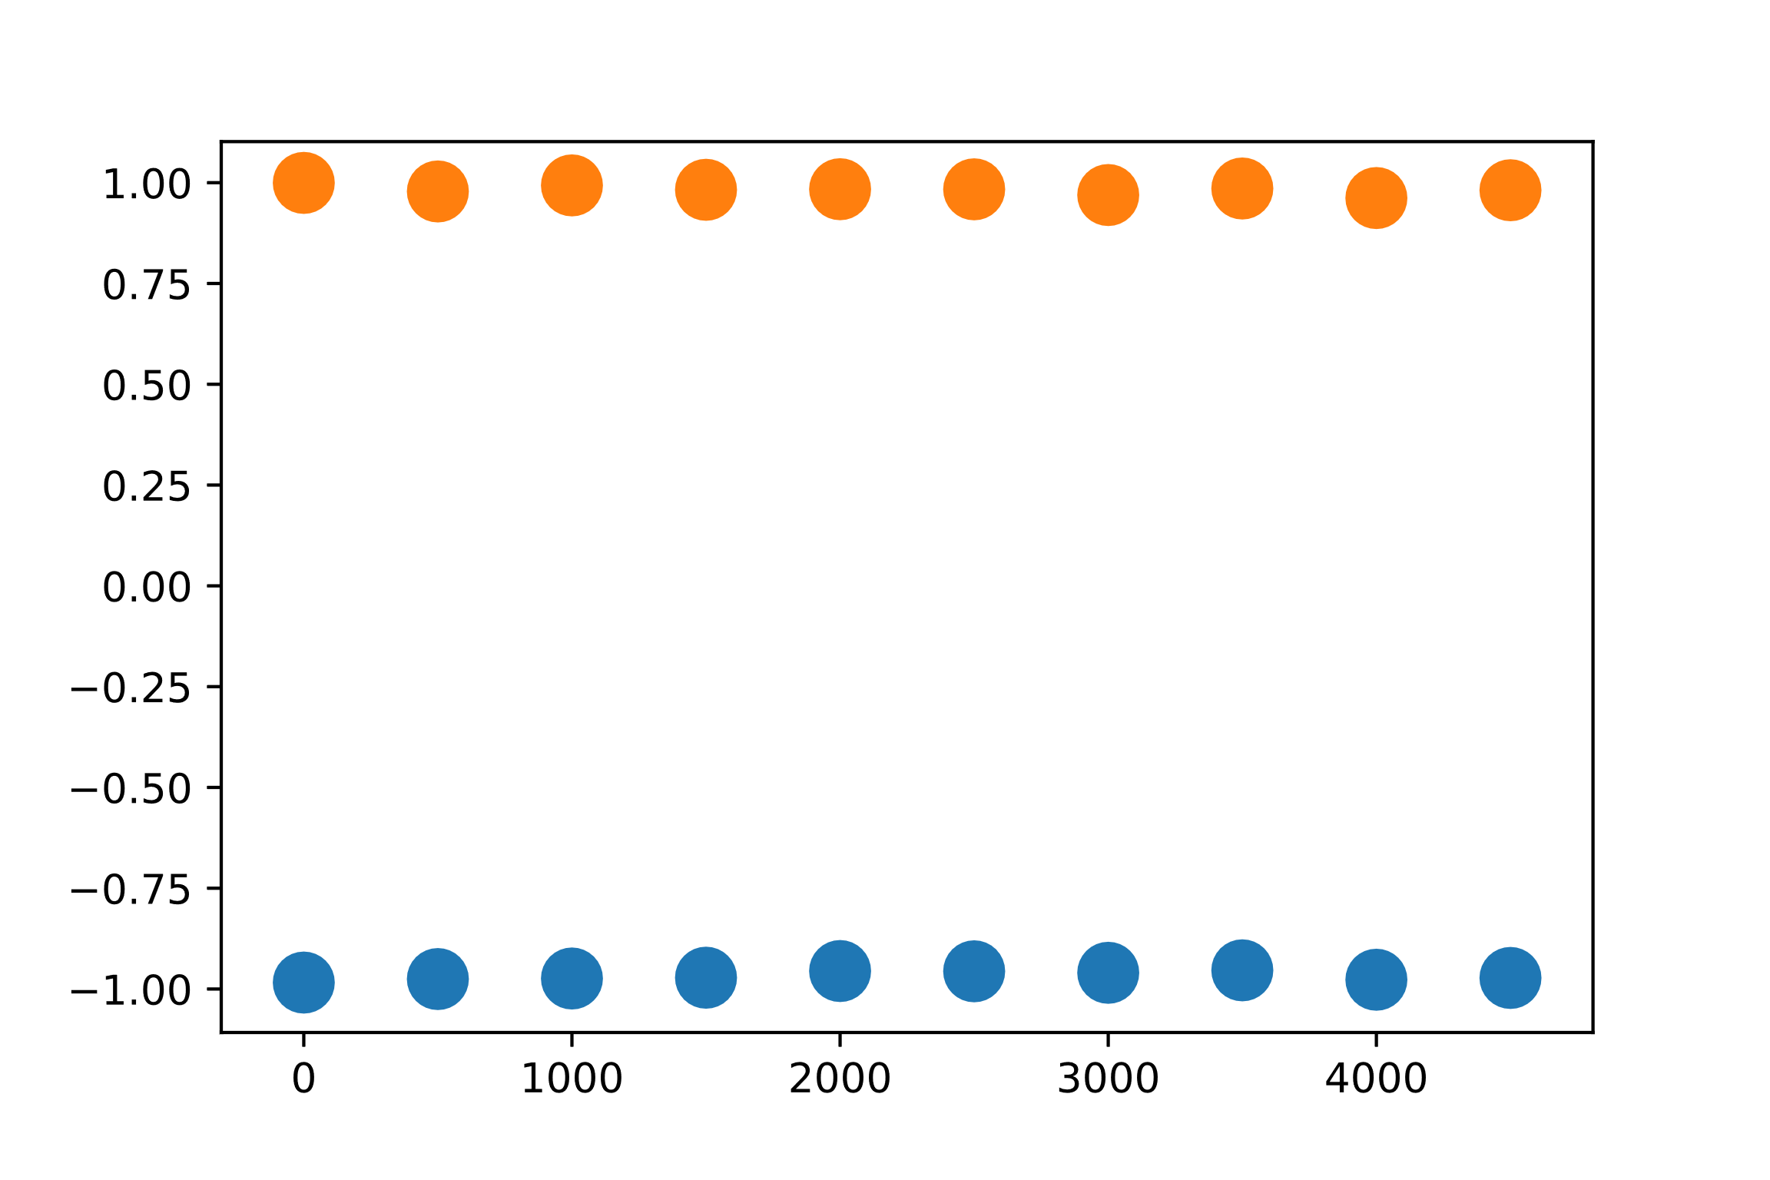
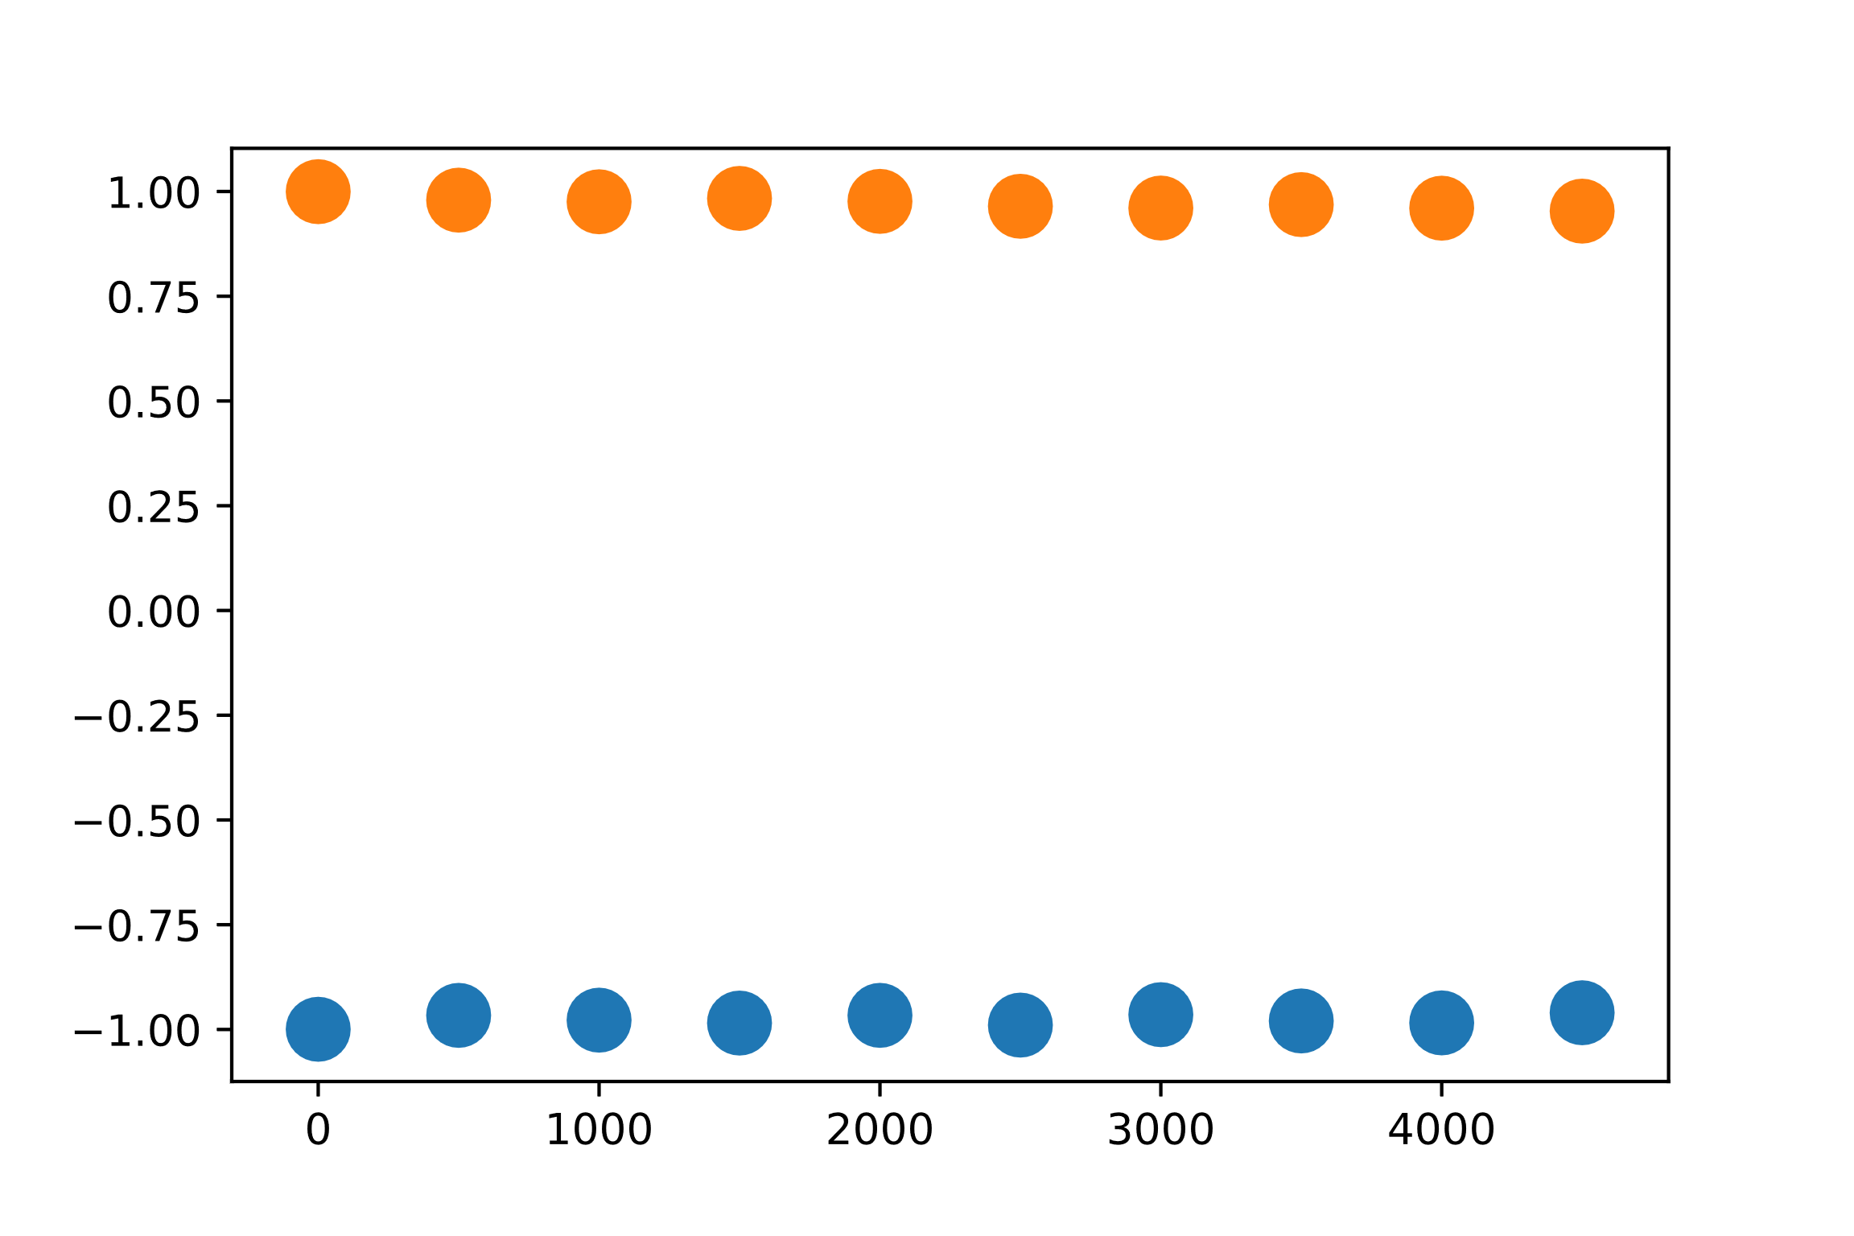
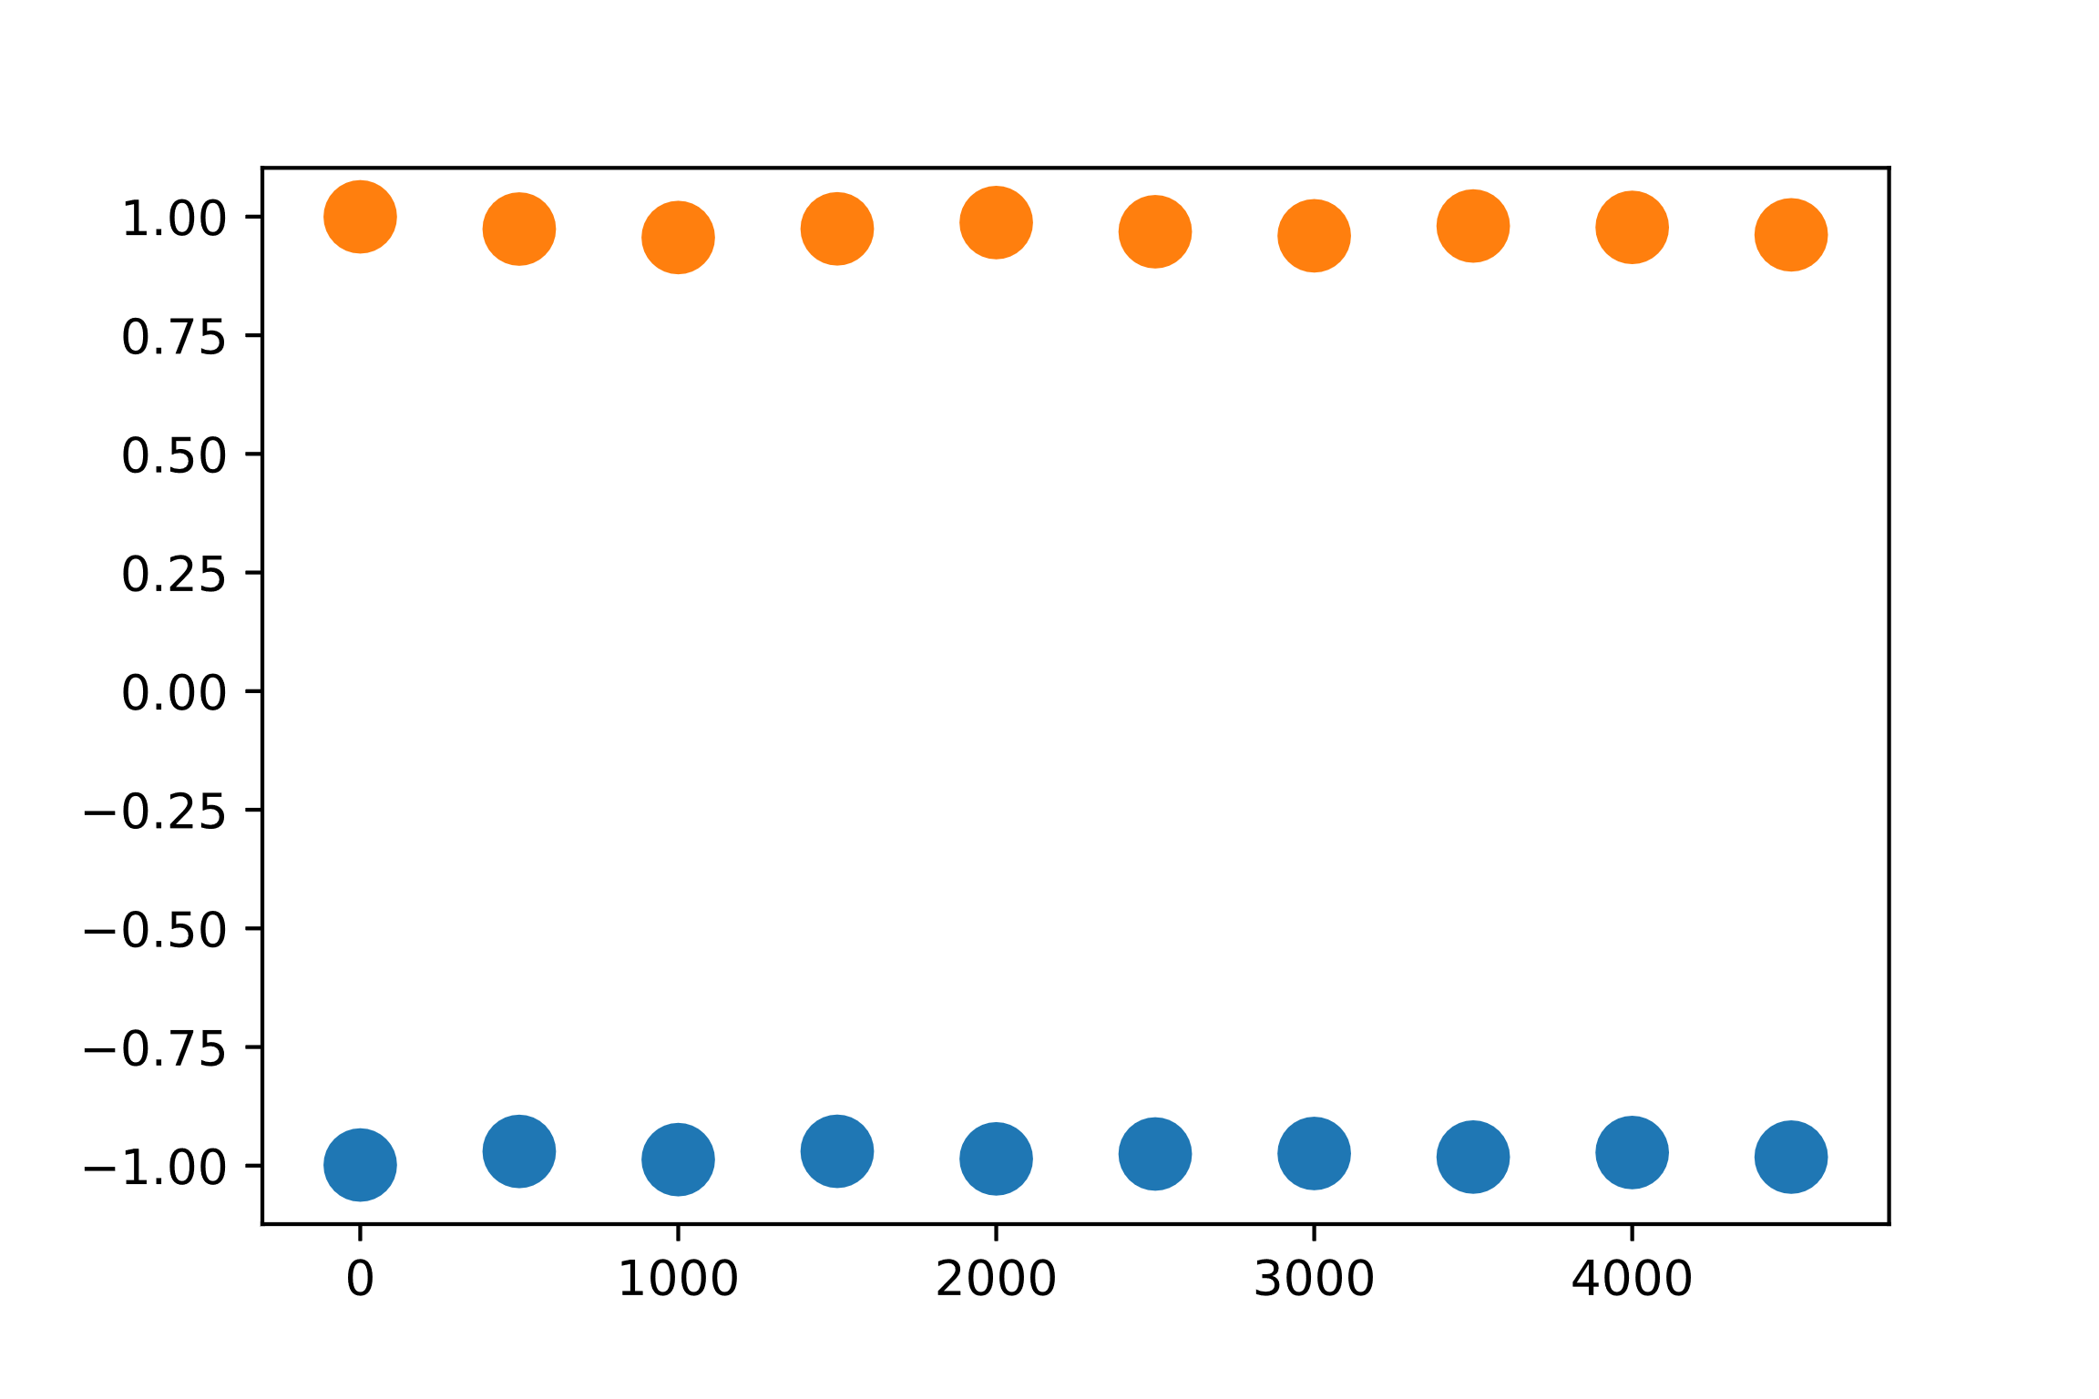
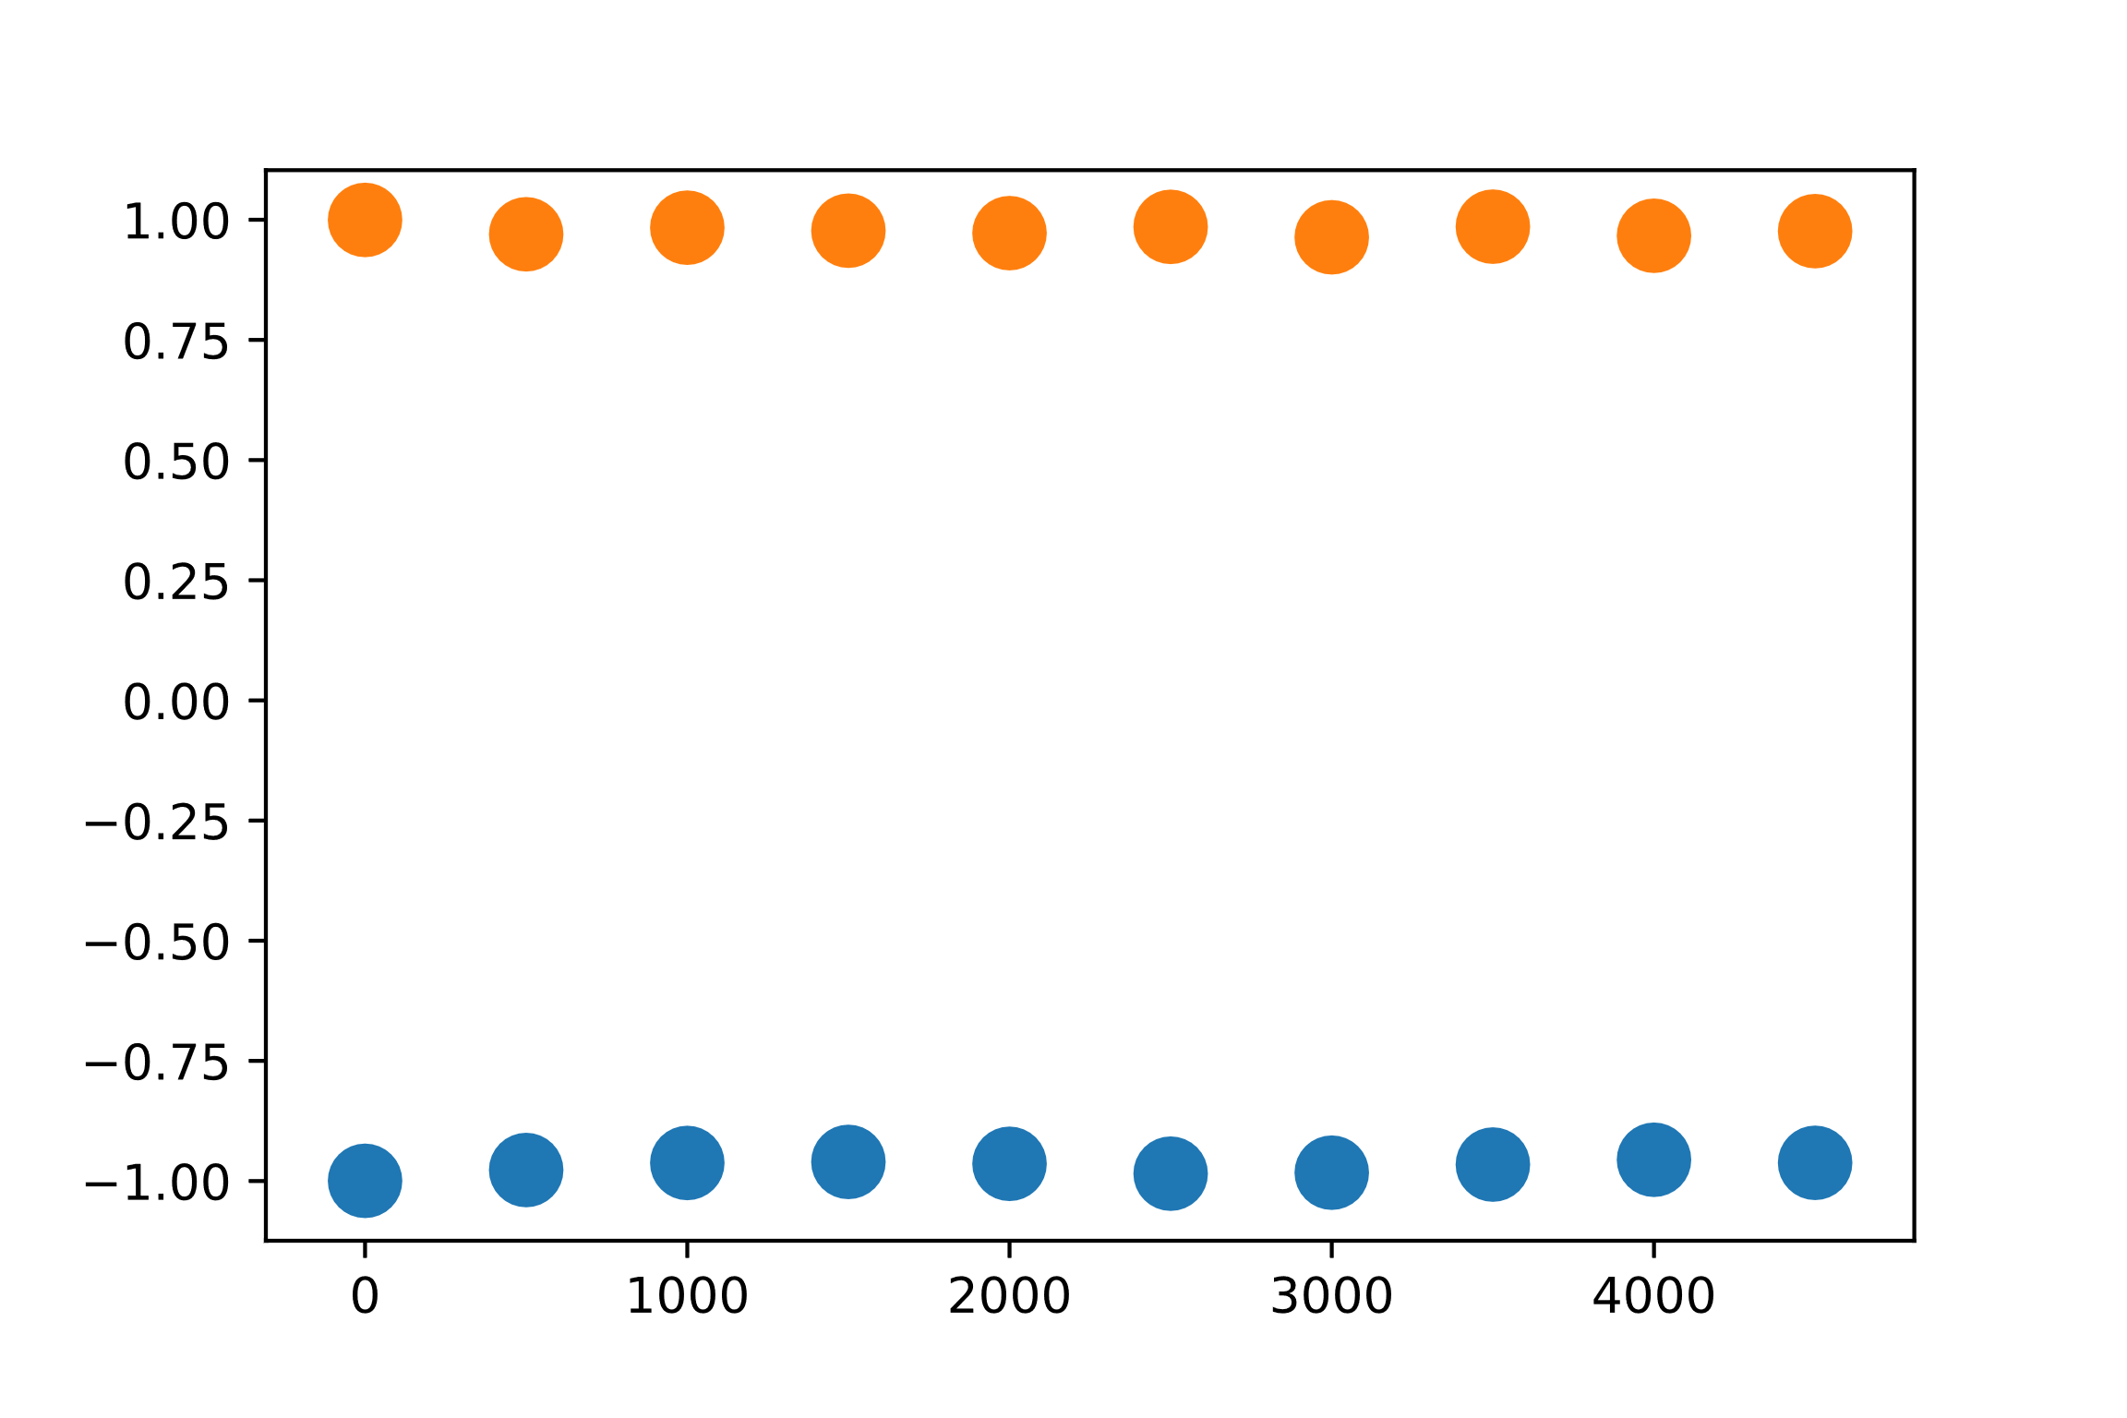
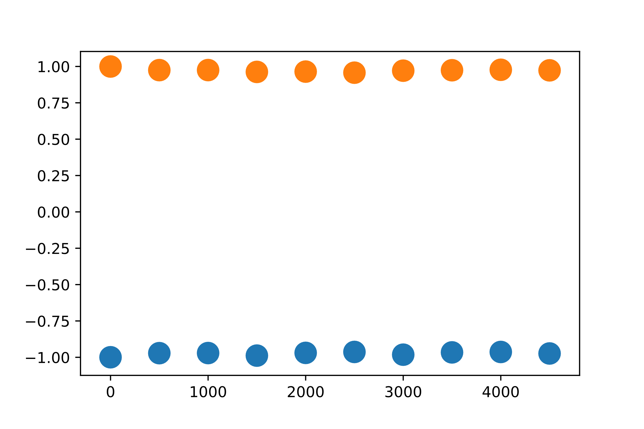
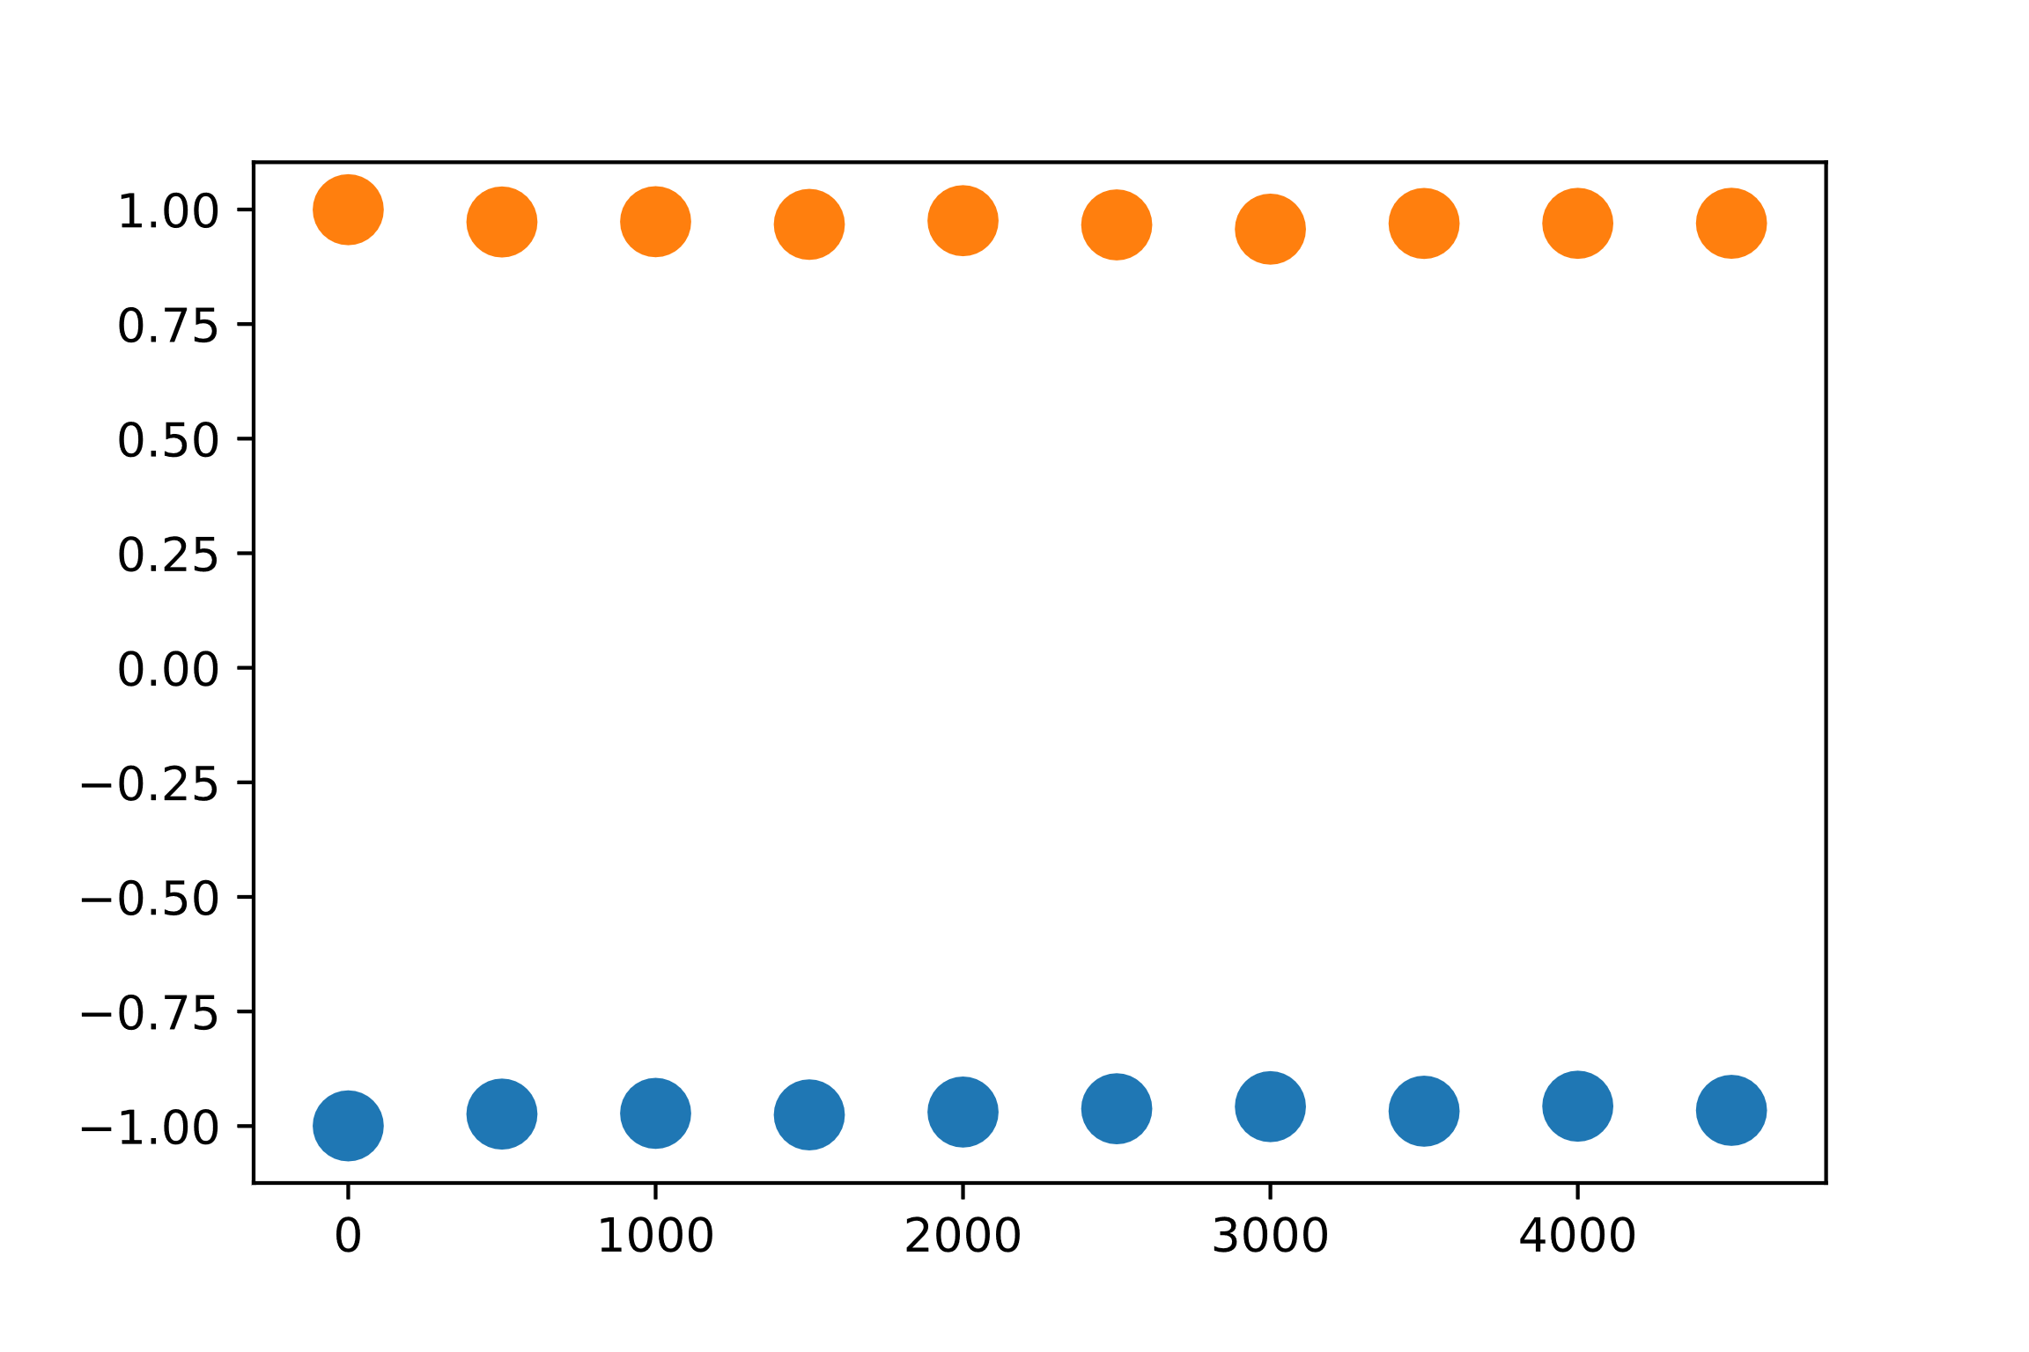
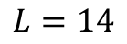
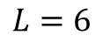
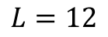
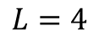
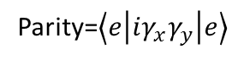
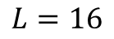
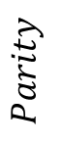
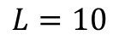
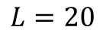
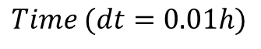
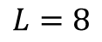
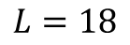
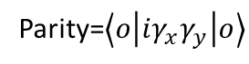
$$L=4$$
$$L=6$$
$$L=8$$
Parity=$\left\langle e | iγ_{x}γ_{y} | e\right\rangle$
$$Parity$$
Parity=$\left\langle o | iγ_{x}γ_{y} | o\right\rangle$
$$Time (dt=0.01h)$$
$$L=10$$
$$L=12$$
$$L=14$$
$$L=16$$
$$L=18$$
$$L=20$$

Slide 3
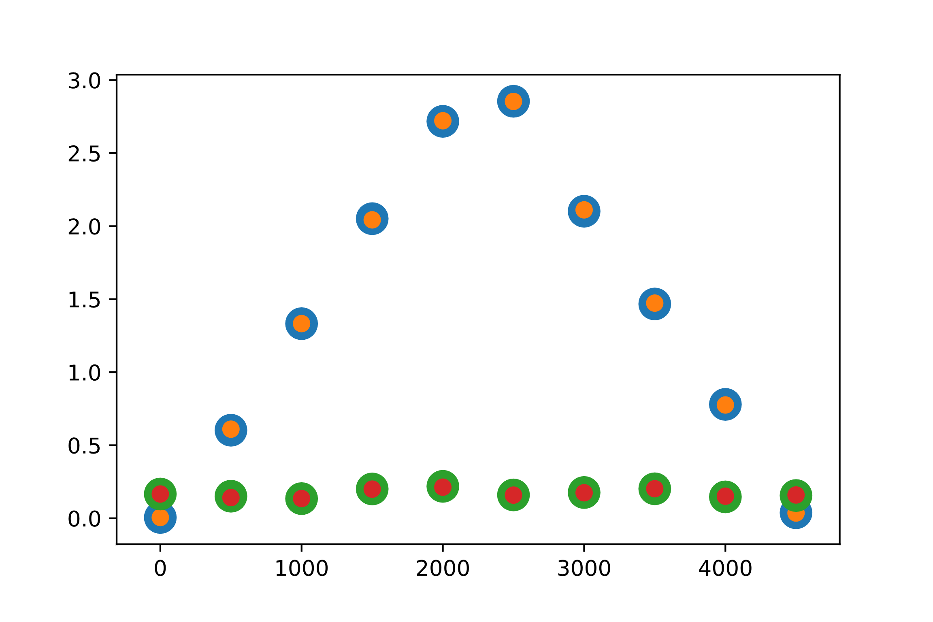
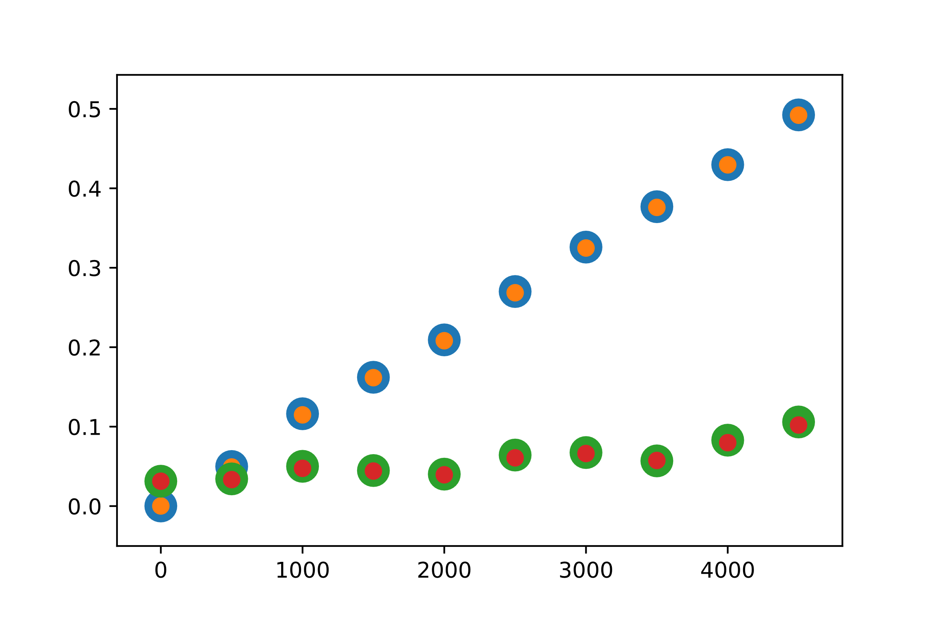
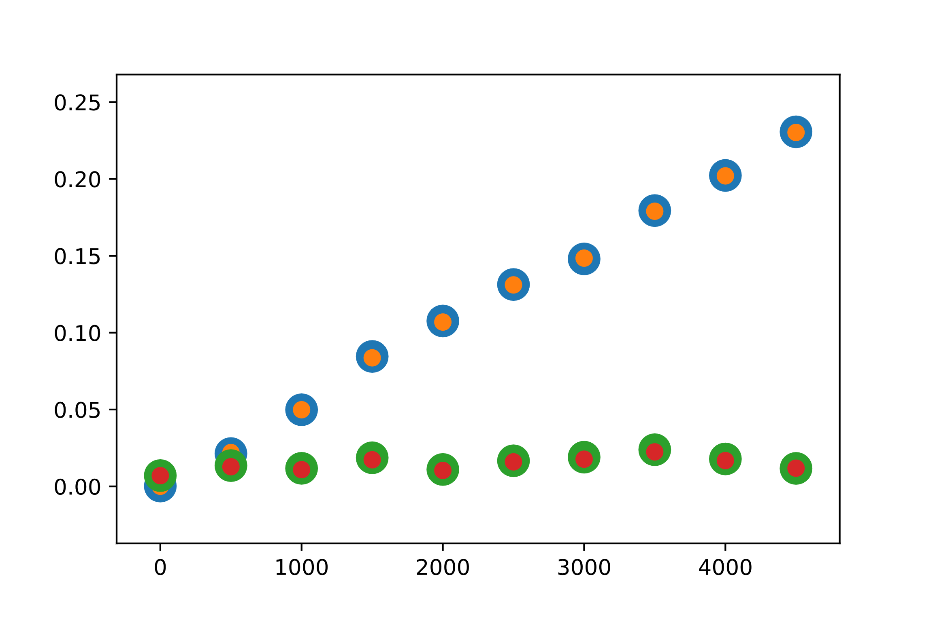
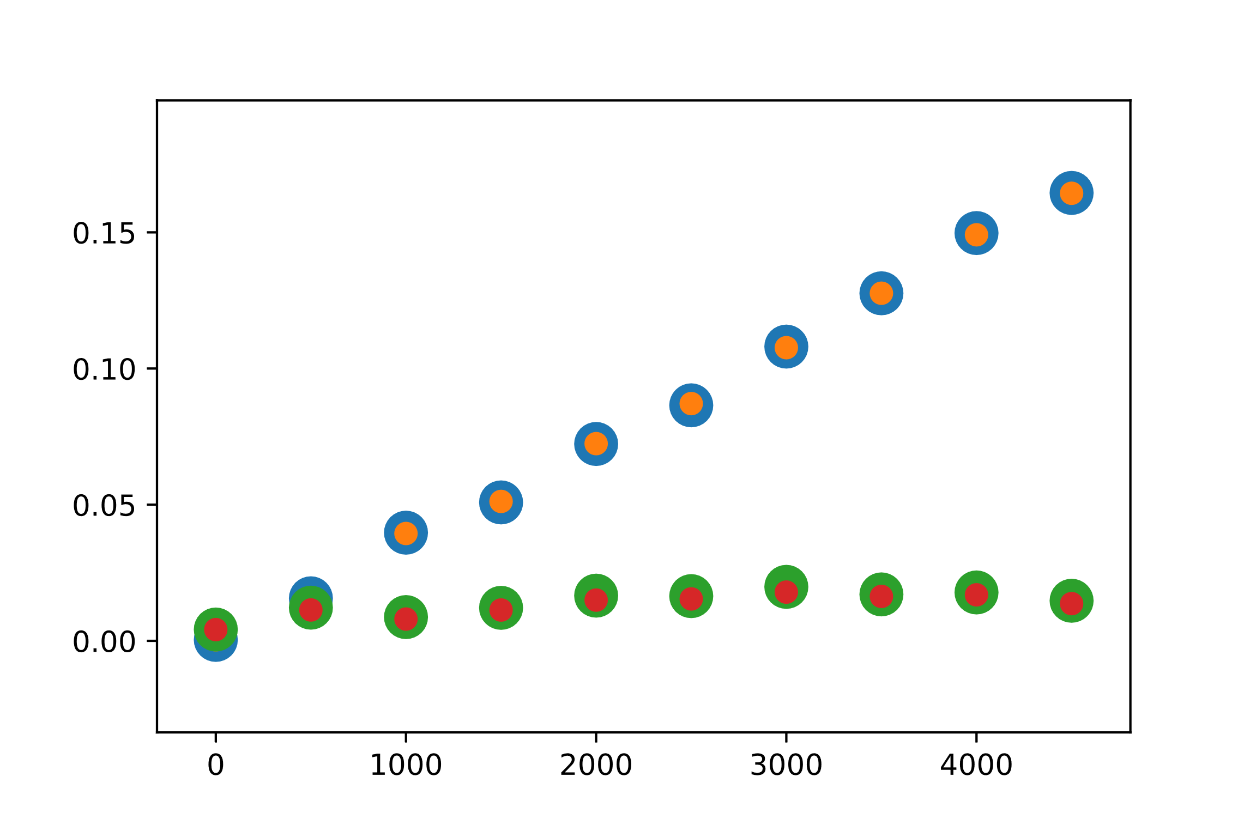
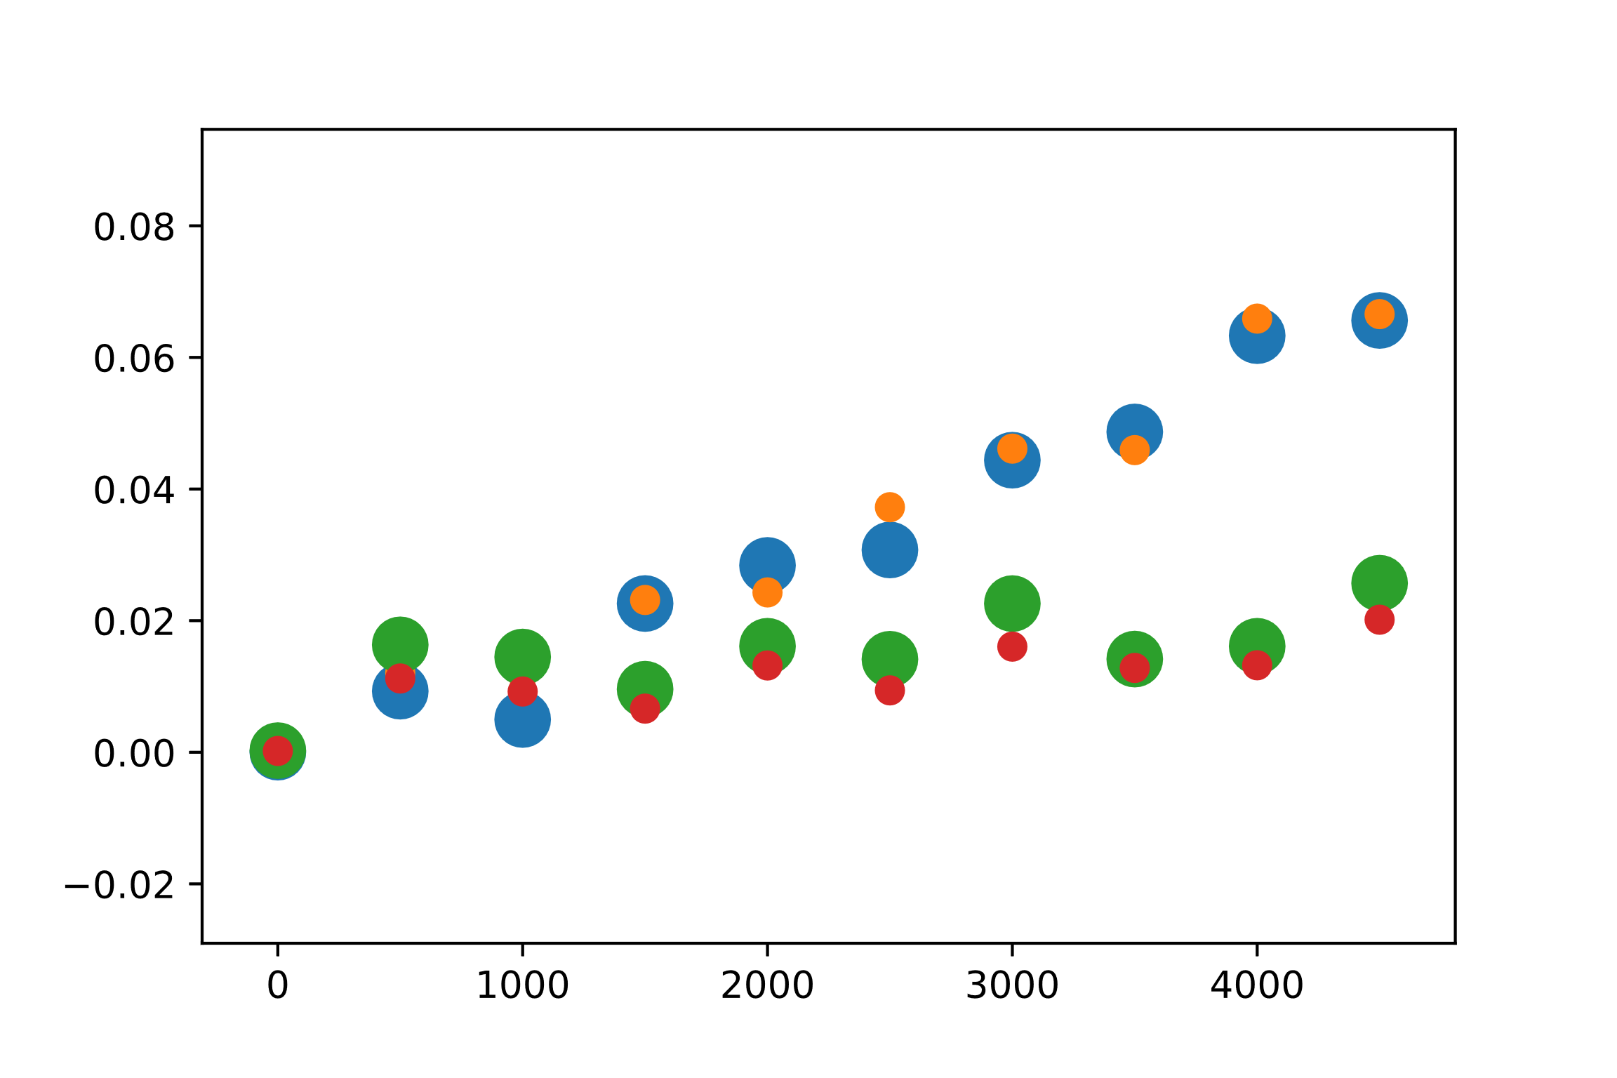
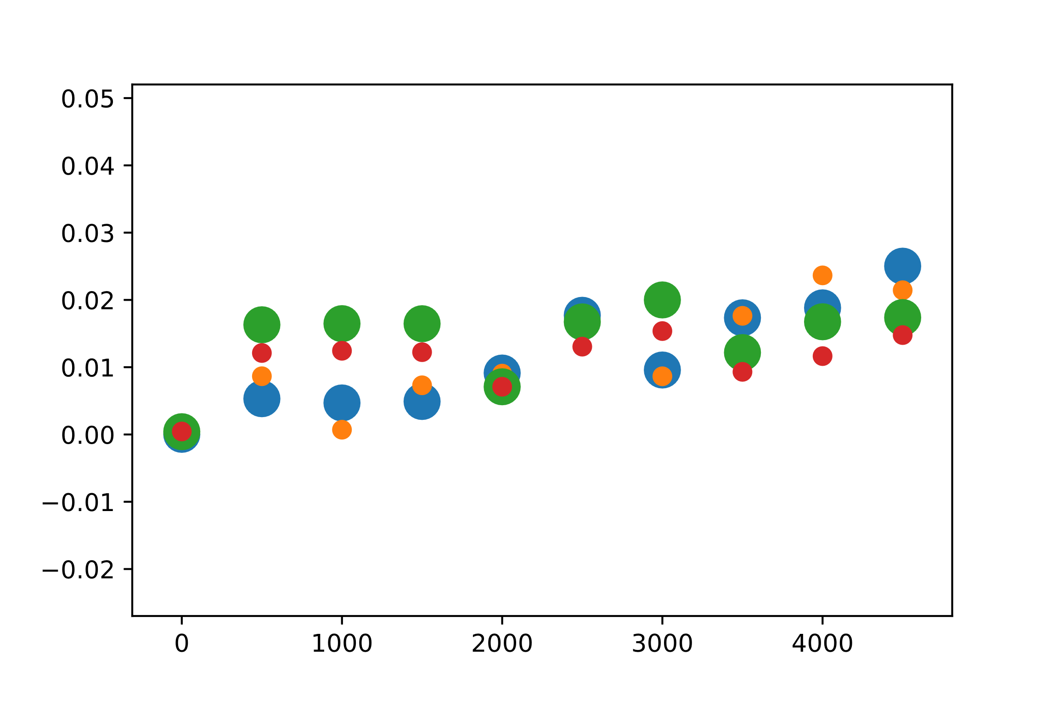
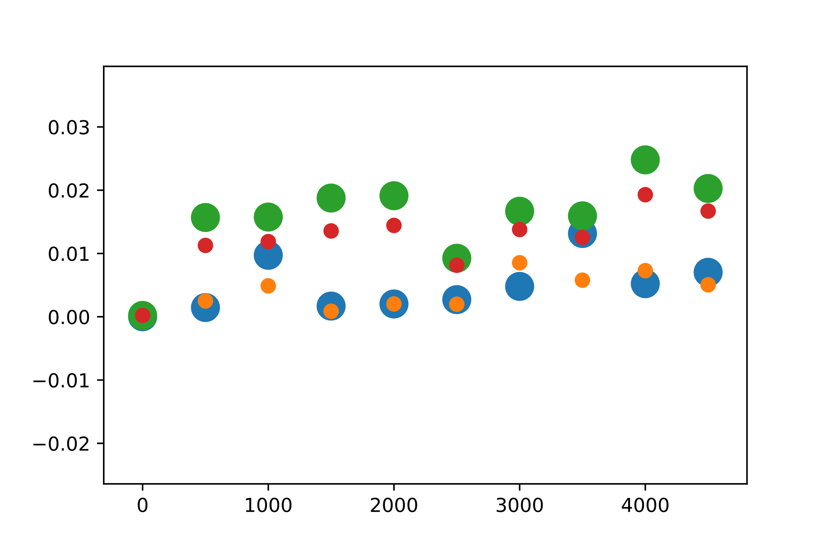
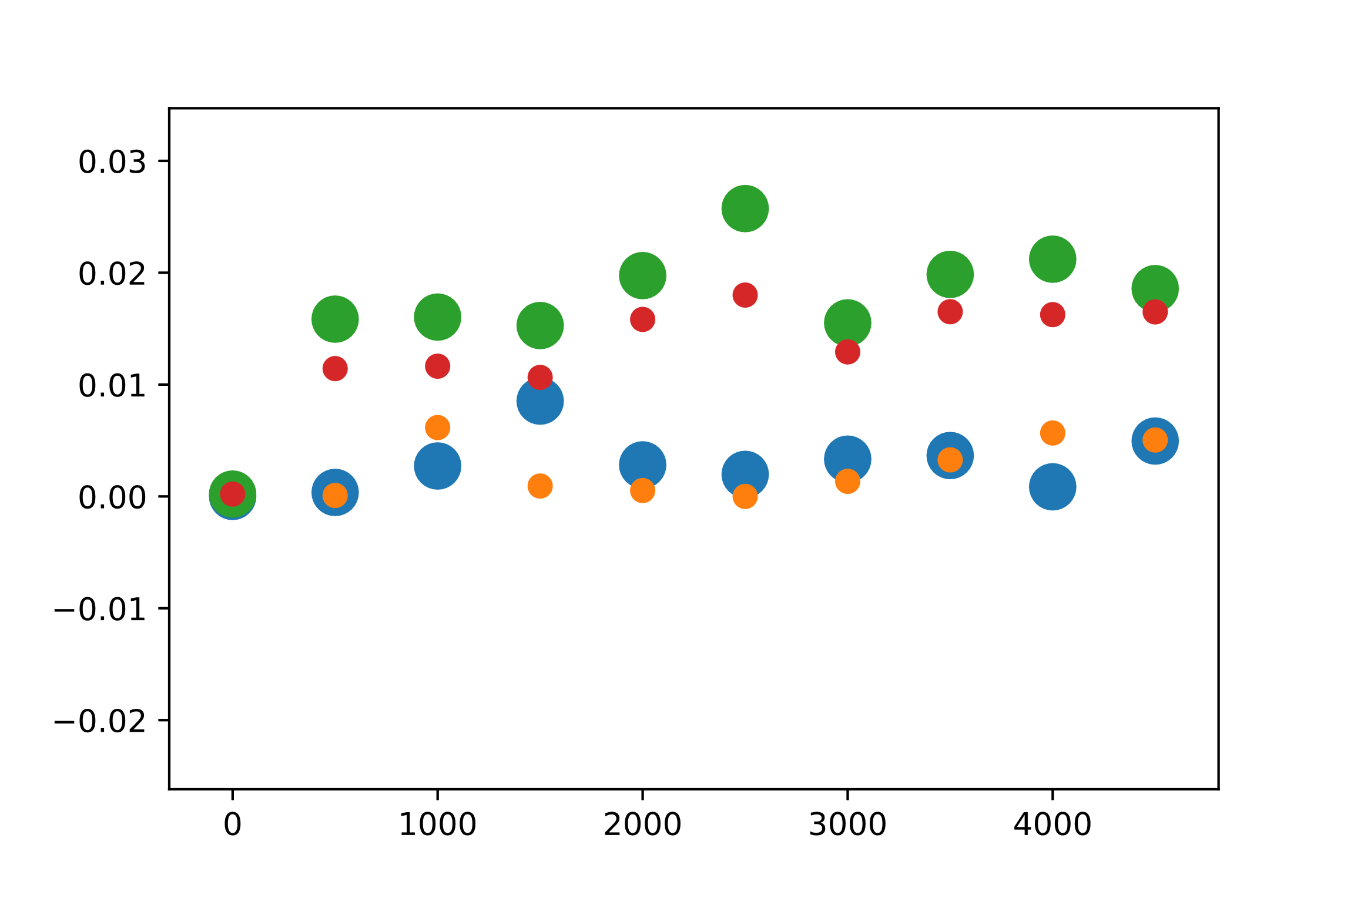
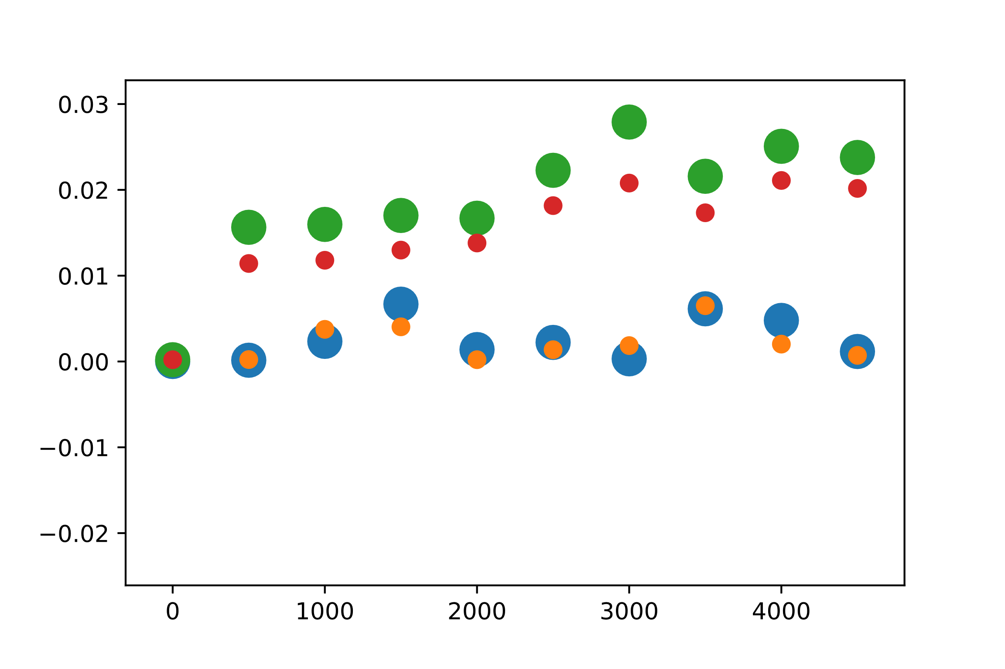
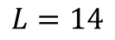
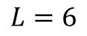
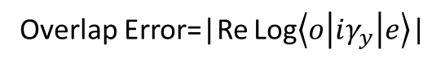
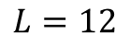
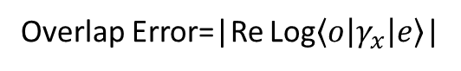
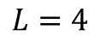
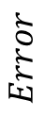
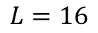
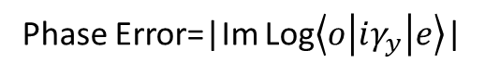
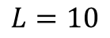
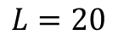
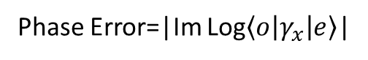
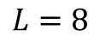
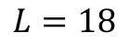
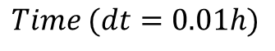
$$L=4$$
$$L=6$$
$$L=8$$
$$Error$$
Phase Error=|Im Log$\left\langle o | γ_{x} | e\right\rangle$|
Phase Error=|Im Log$\left\langle o | iγ_{y} | e\right\rangle$|
Overlap Error=|Re Log$\left\langle o | γ_{x} | e\right\rangle$|
$$Time (dt=0.01h)$$
Overlap Error=|Re Log$\left\langle o | iγ_{y} | e\right\rangle$|
$$L=10$$
$$L=12$$
$$L=14$$
$$L=16$$
$$L=18$$
$$L=20$$

Slide 4
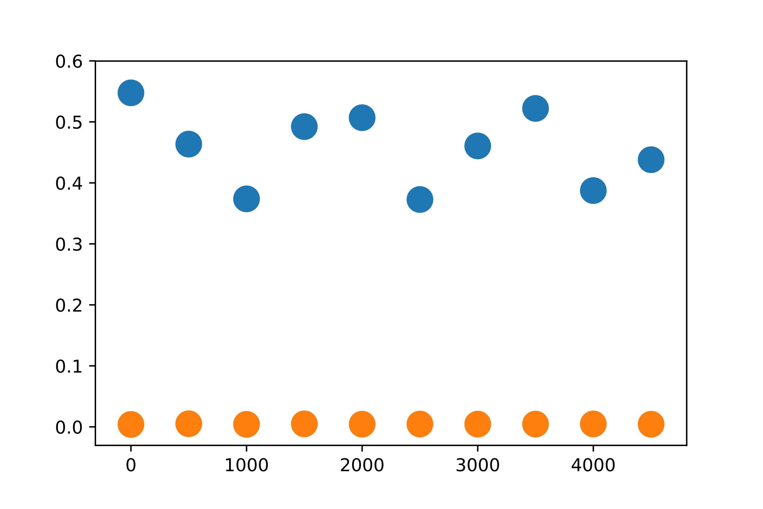
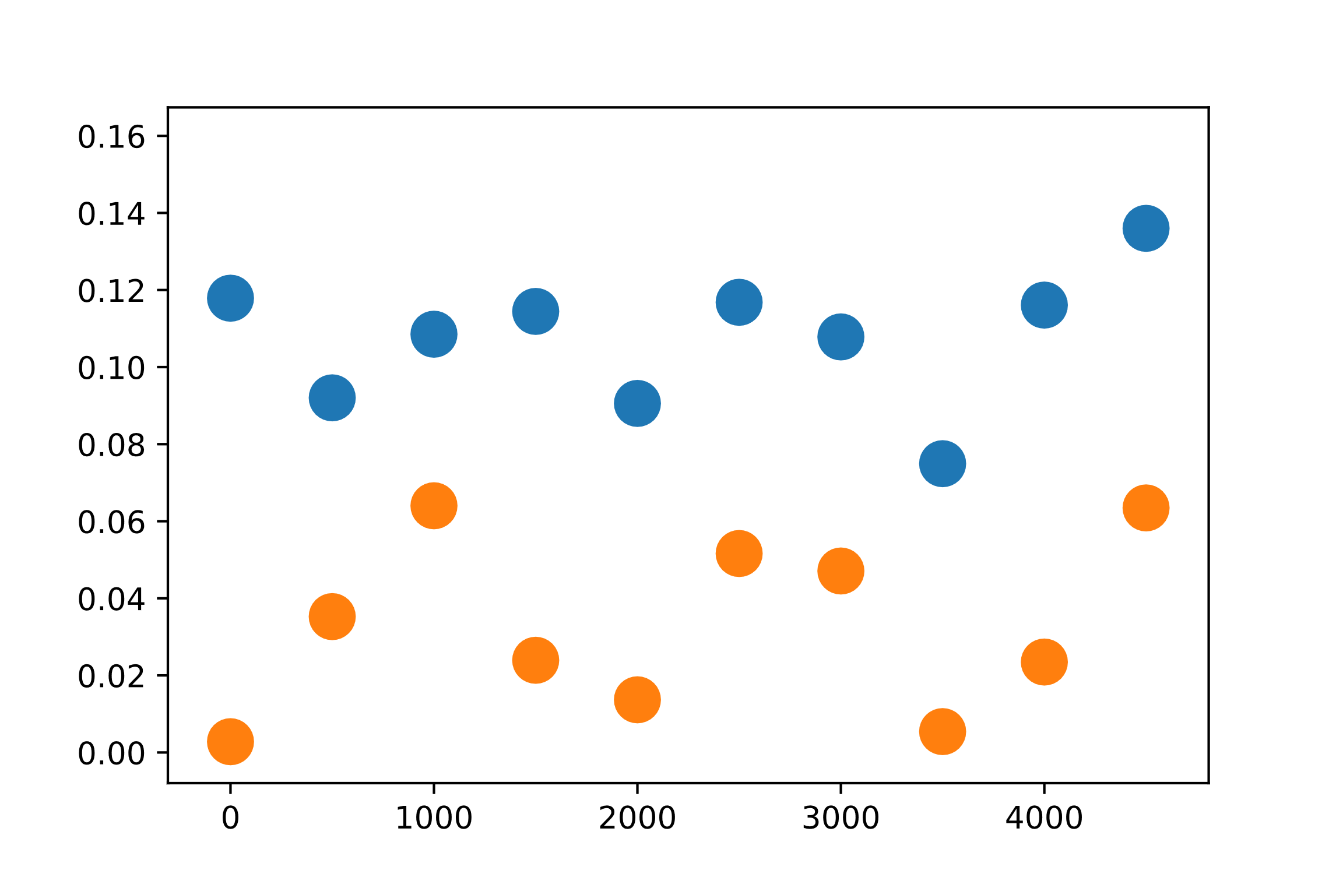











Parity Shift=1-|$\left\langle e | iγ_{x}γ_{y} | e\right\rangle |$
$$Parity Shift$$
Parity Shift=1-|$\left\langle o | iγ_{x}γ_{y} | o\right\rangle |$
$$Time (dt=0.01h)$$

Slide 5























$$t=5$$
$$t=10$$
$$t=15$$
$$t=20$$
$$Error$$
$Length$
$$t=25$$
$$t=30$$
$$t=35$$
$$t=40$$
$$t=45$$
$$t=50$$
Phase Error=|Im Arg$\left\langle o | γ_{y} | e\right\rangle$|

Slide 6




















$$t=5$$
$$t=25$$
$$t=15$$
$$t=50$$
$$Parity Shift$$
$Length$
$$t=5$$
$$t=25$$
$$t=15$$
$$t=50$$
Parity Shift=1-|$\left\langle e | iγ_{x}γ_{y} | e\right\rangle |$
Parity Shift=1-|$\left\langle o | iγ_{x}γ_{y} | o\right\rangle |$

Slide 7























T$=5$
$$t=10$$
$$t=15$$
$$t=20$$
$$Log Error$$
$Length$
$$t=25$$
$$t=30$$
$$t=35$$
$$t=40$$
$$t=45$$
$$t=50$$
Phase Error=|Im Log$\left\langle o | γ_{y} | e\right\rangle$|

Slide 8
















$$t=5$$
$$t=25$$
$$t=15$$
$$t=50$$
$$Log Parity Shift$$
$Length$
$$t=5$$
$$t=25$$
$$t=15$$
$$t=50$$
Log Parity Shift=log(1-|$\left\langle e | iγ_{x}γ_{y} | e\right\rangle |)$
Log Parity Shift=log(1-|$\left\langle o | iγ_{x}γ_{y} | o\right\rangle |)$

Slide 9









L=12
L=14
L=16

Slide 10




L=12
L=16

Slide 11




N=2
L=16

Slide 12
List of things John will definitely not forget to DO
Check total parity at the end of run X
Write down all that shit on Roger’s board X
Check Energy difference of ground states for V=0 and V=Vmax X
For Umax=0 X
Do as a function of U – figure out the order in perturbation theory X
As a function of Bond Dimension X
Zap before ramp up X
AS a function of tr – look at errors in parity X
For every plot check n=0 ~

Slide 13
Setting up TEBD for cluster
U_MPO_zdesvd remnamed to U_MPO X
Copy TEBD clean into another folder then start deleting files ~
Fix Emid using MPO_time ~
Save data at the end of the runfile or after each run step using “While Open”
Standardize the save notation and start new folder
Should have a TEBD for each variable (at most) and supporting files

